Slide 1

Implementation of an Opening Resistor to Mitigate TRV in a Hydroelectric Project in the Peruvian Electrical System
Inel

Slide 2
Introduction
Ensuring the reliability and stability of energy generated in Peruvian hydroelectric projects requires mitigating Transient Recovery Voltages (TRV) during switching operations.
This presentation evaluates the TRV of circuit breakers in a hydroelectric plant and proposes pre-insertion or opening resistors if IEC 62271-100 and IEEE C37.10 standards are not met.
Using EMTP software, the substation and transmission line components are accurately modeled to analyze the effectiveness of the mitigation measures.
In scenarios with TRV levels exceeding the circuit breakers' withstand capability, the effectiveness of the proposed resistors is evaluated.
The goal is to improve the operational reliability of the hydroelectric project and ensure compliance with safety and performance standards.

Slide 3
Methodology

Slide 4
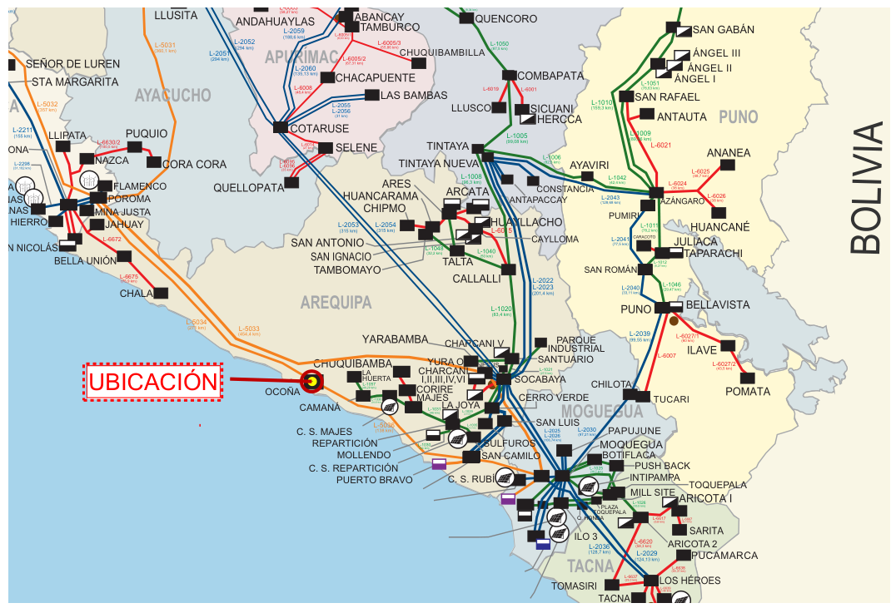
Data Collection
Real case study
Project information
The hydroelectric plant has a generation capacity of 170 MW, with two generation units with a power of 100 MVA at 13.8 kV.
Two three-phase 2-winding 13.8/220kV transformers with a capacity of 100 MVA (ONAF).
Simple triple transmission line in 220 kV of 78.44 km.
A three-phase 3-winding autotransformer at 500/220/33 kV with a capacity of 200/200/2.5 (ONAF). Interconnecting at a 500 kV substation

Slide 5
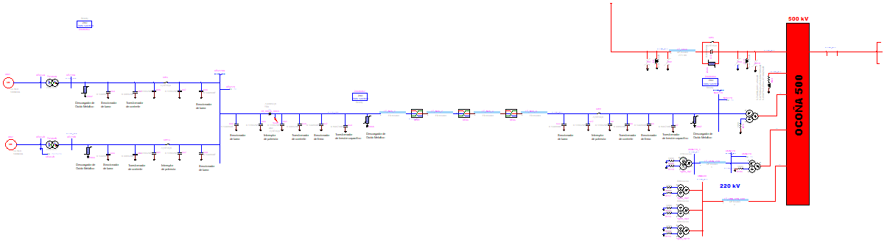
Modelling
Hydroelectric power station
three phase transformer
13.8/220 kV
Three-phase autotransformer
500/220/33 kV
Generation units
Transmission line
78.44 km

Slide 6
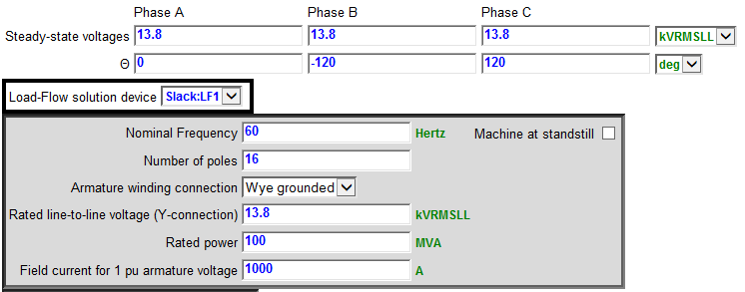
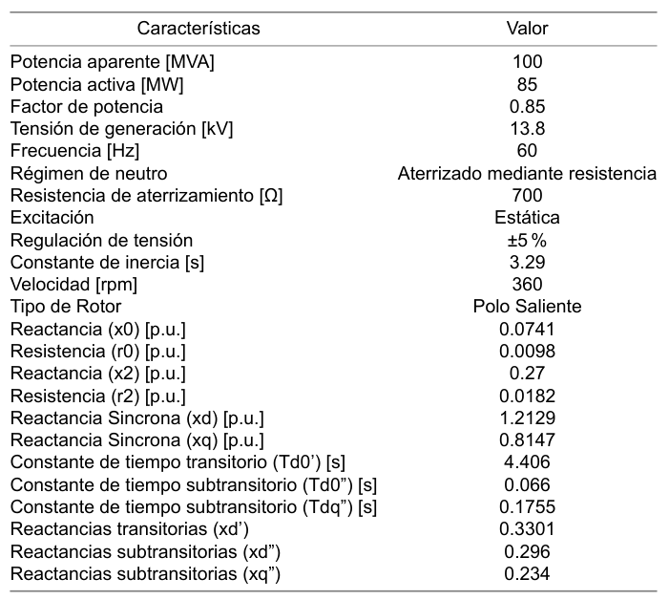
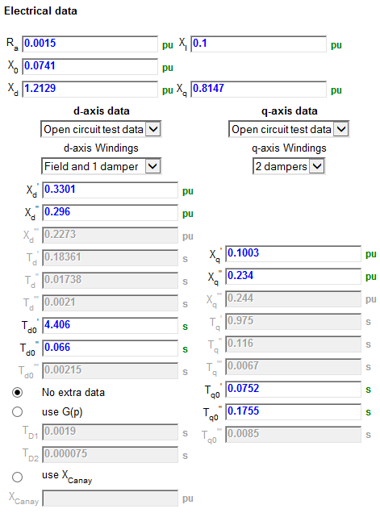
Modelling
Hydroelectric power station
Generation units
The electrical parameters of conventional synchronous generators are presented.

Slide 7
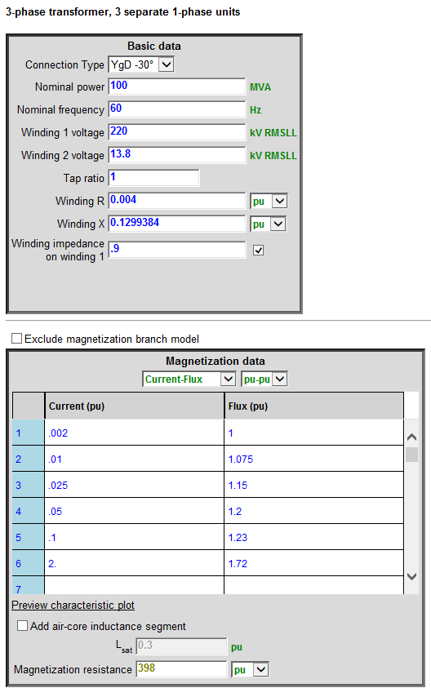
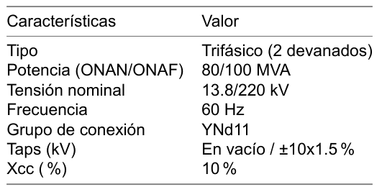
Modelling
Hydroelectric power station
2 winding transformers
The electrical parameters of the transformers used for system modelling are presented.

Slide 8
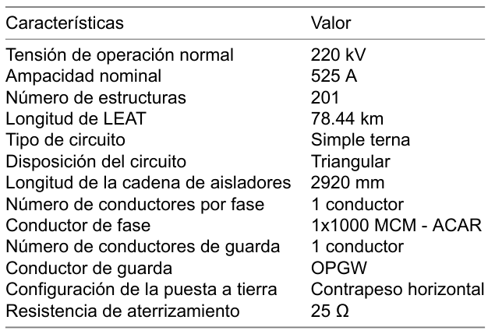
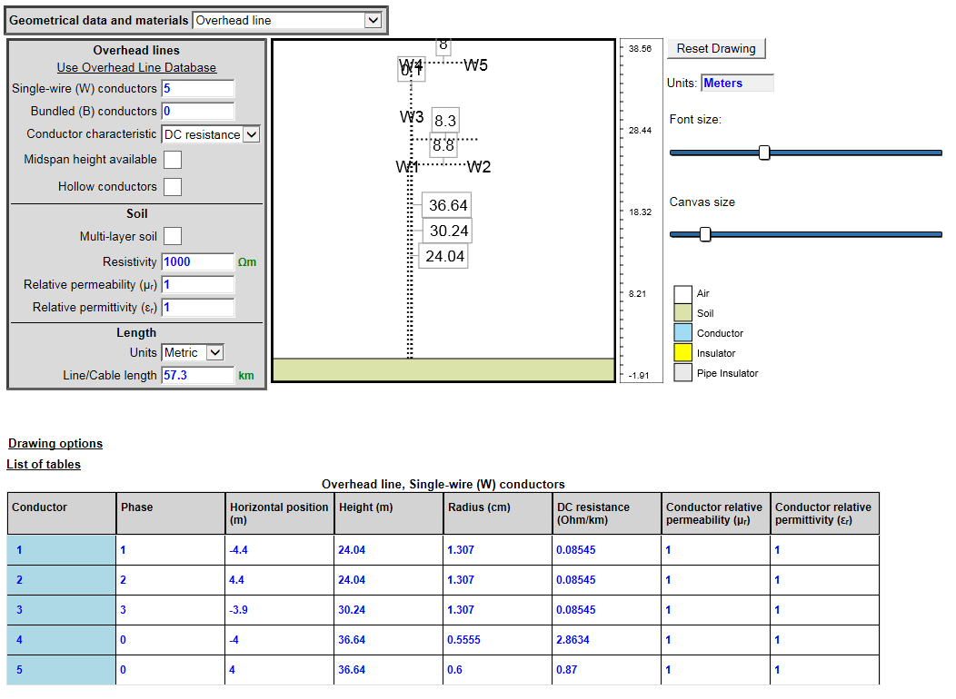
Modelling
Hydroelectric power station
Transmission line
The parameters of the transmission line are presented below:

Slide 9
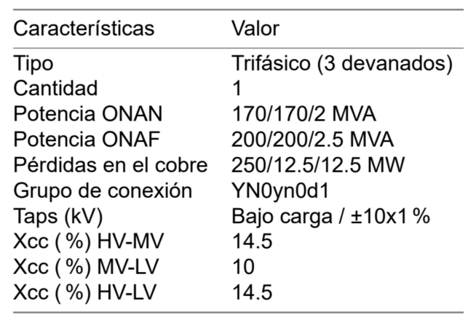
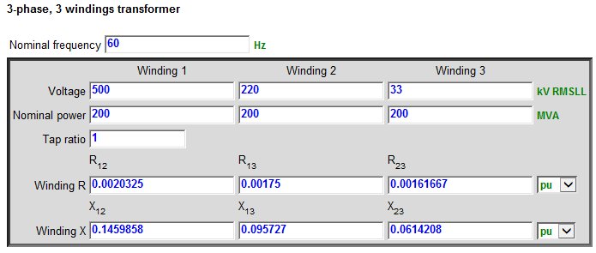
Modelling
Hydroelectric power station
3 winding autotransformer
The electrical parameters of the autotransformer used for system modelling are presented.

Slide 10
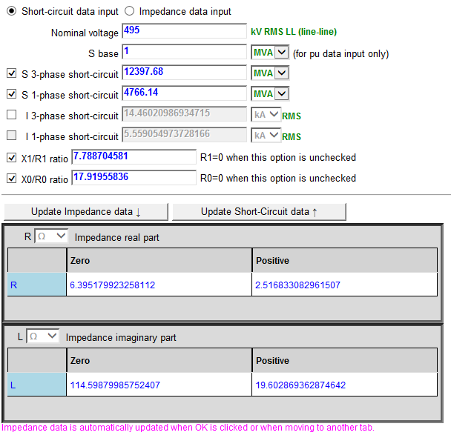
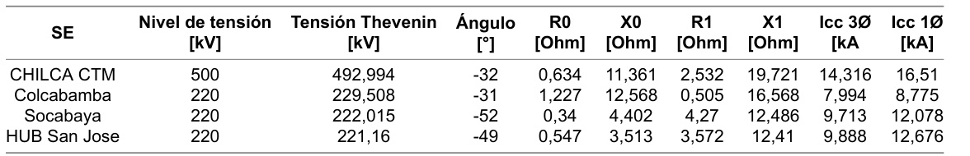
Modelling
Hydroelectric power station
Network equivalents
The network equivalents at the substations were modeled as ideal voltage sources in series with a symmetrical RL equivalent

Slide 11
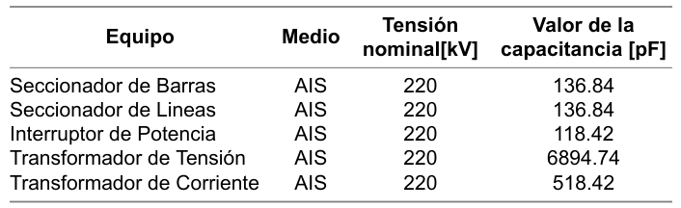
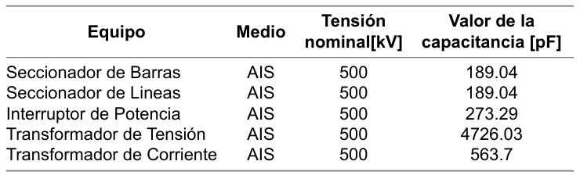
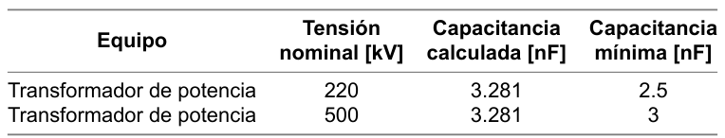
Modelling
Hydroelectric power station
Parasitic capacitances
The capacitances associated with the equipment installed in the substation were modeled in detail.
On the 220 kV side
On the 500 kV side
Power transformer
Notes:
These transformer capacitance values have been estimated in accordance with Figure B.2 of the IEEE C37.011 standard.

Slide 12
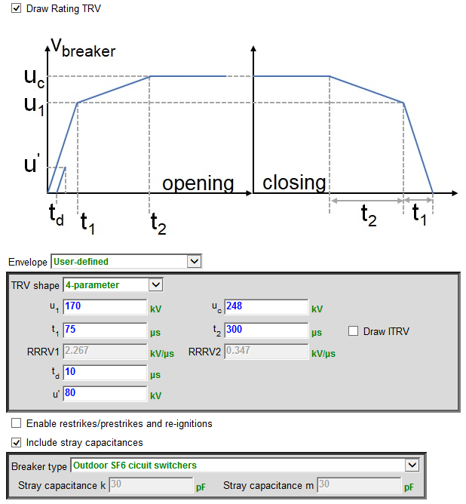
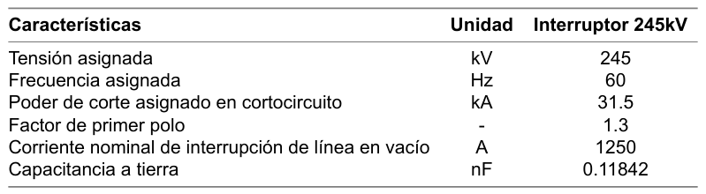
Modelling
Hydroelectric power station
Circuit breaker
The existing "Breaker for TRV" device in the EMTP program is used.
The most relevant technical characteristics of the circuit breakers to be installed in the project's fields are shown.

Slide 13
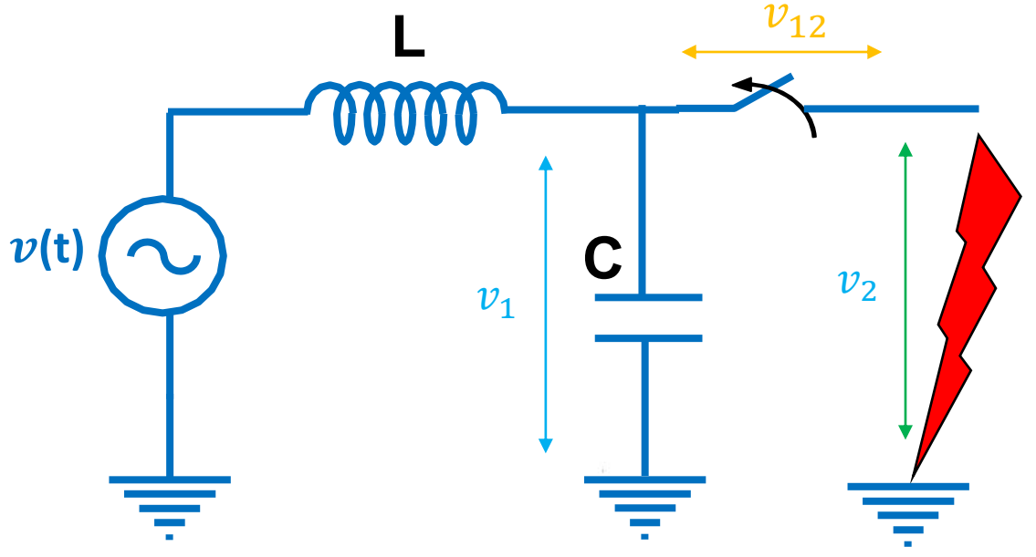
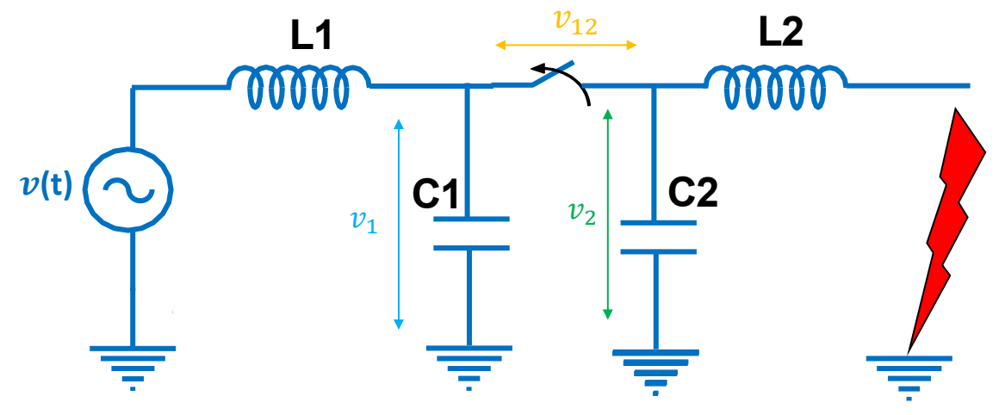
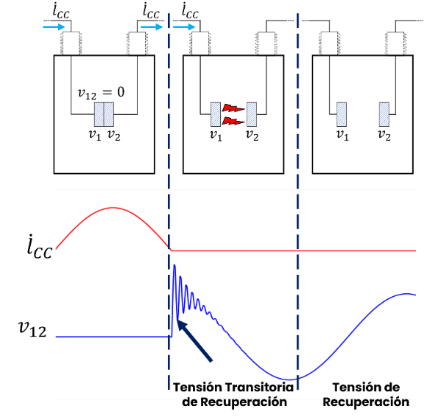
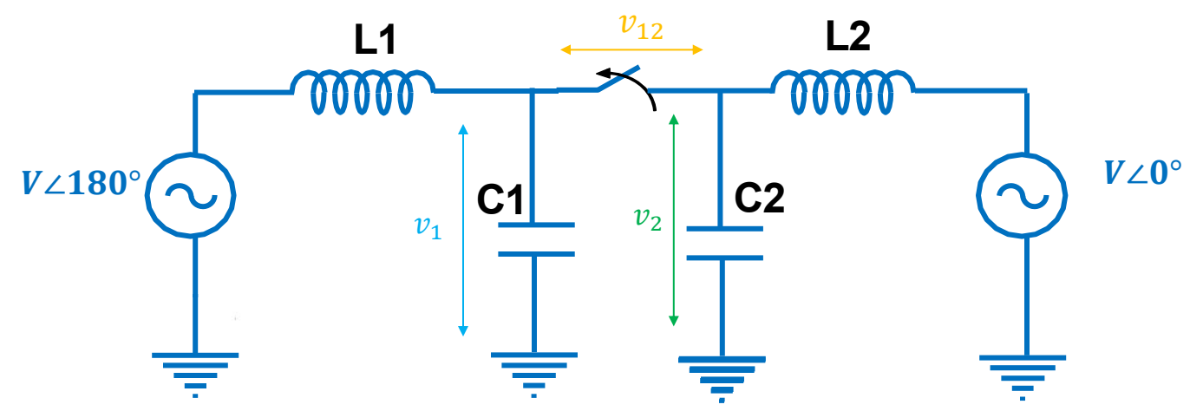
TRV evaluation
In this section, the results obtained from various simulations of the project are presented.
The aim is to analyze the maximum dielectric stresses between terminals to which the circuit breakers will be exposed under extreme operating conditions, using TRV and RRRV parameters.
The simulated contingencies are:
Out-of-phase opening.
Opening with terminal faults.
Opening of line with kilométric fault.

Slide 14
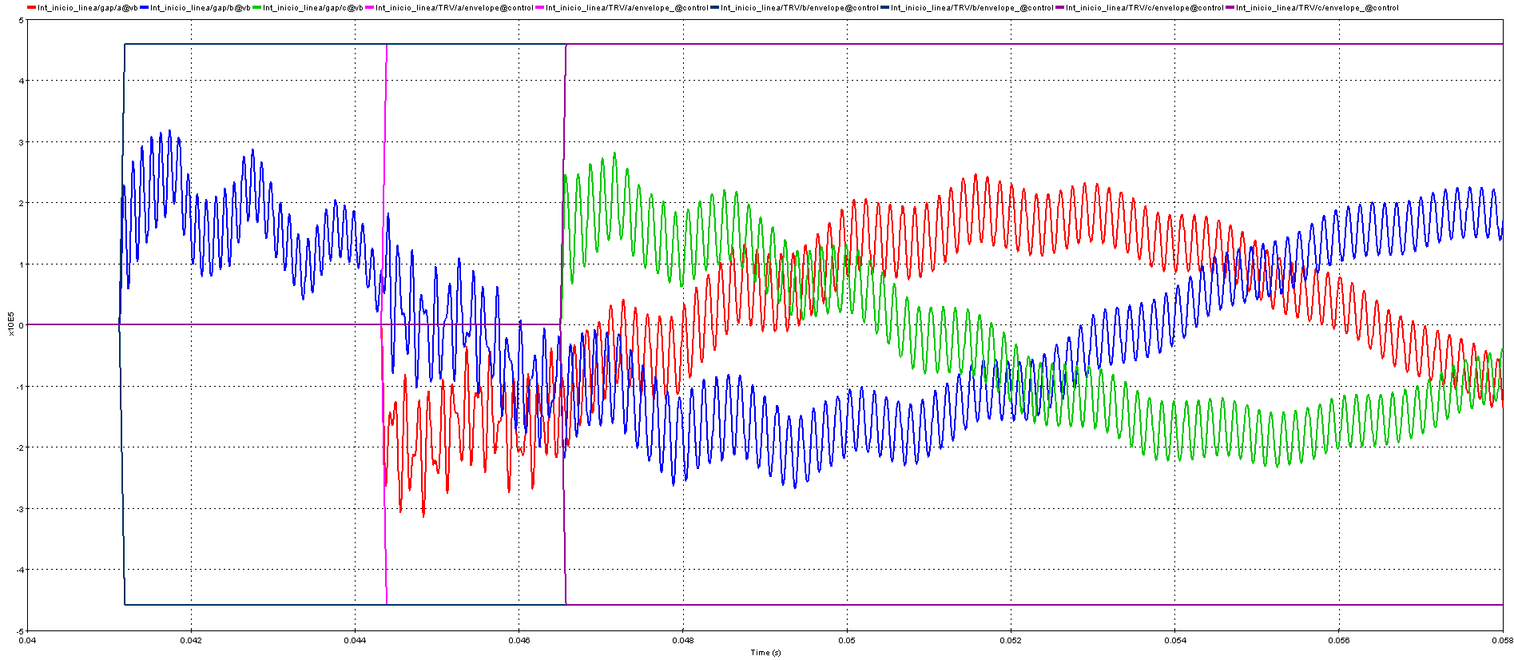
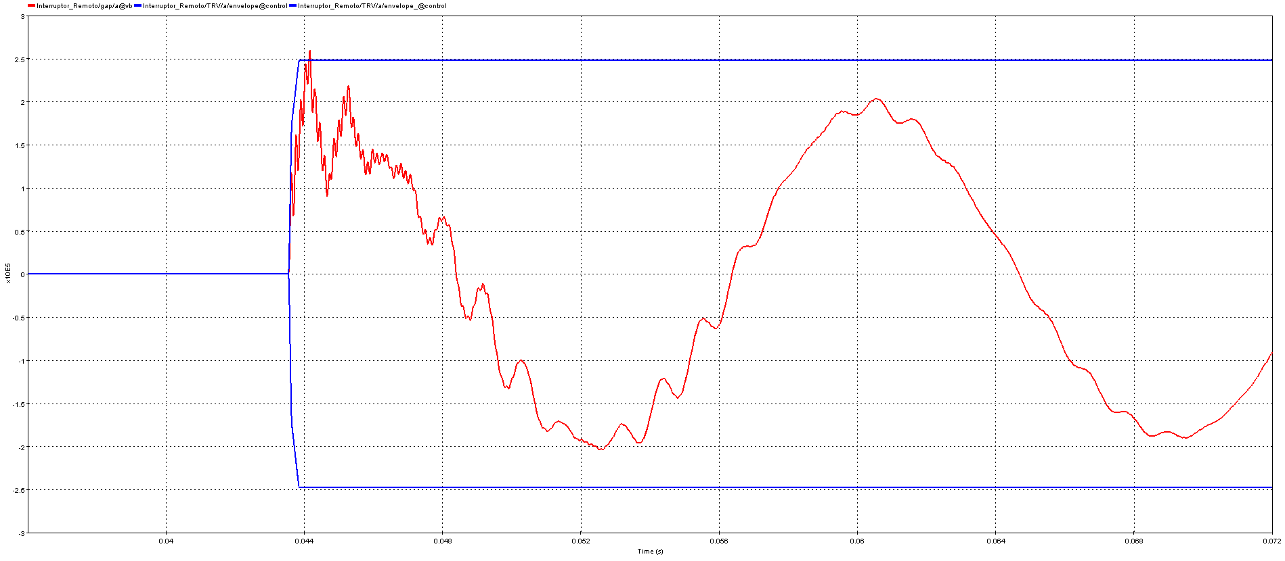
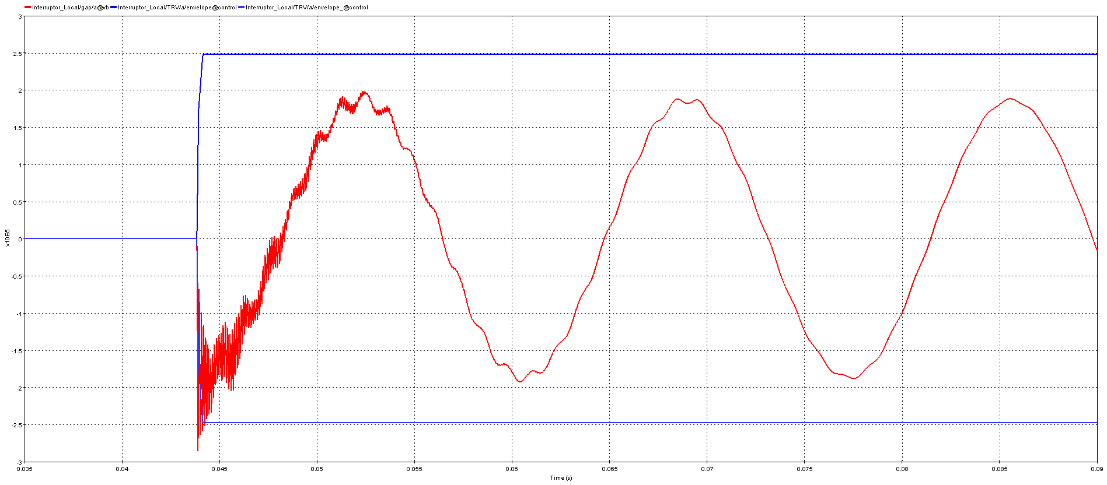
TRV evaluation
Evaluation of TRV in transmission lines

Slide 15
TRV evaluation
Evaluation of TRV in transmission lines

Slide 16
Improvement of TRV
In this section, the results obtained after the incorporation of mitigation actions are presented.
This involves the installation of pre-insertion resistors in the line circuit breakers located in the project's substation.
The aim is to analyze the maximum dielectric stresses between terminals to which the circuit breakers will be exposed under extreme operating conditions, using TRV and RRRV parameters.
The simulated contingencies are:
Out-of-phase opening.
Opening with terminal faults.
Opening of line with kilométric fault.
Line Switch Representation
Pre-insertion Resistor

Slide 17
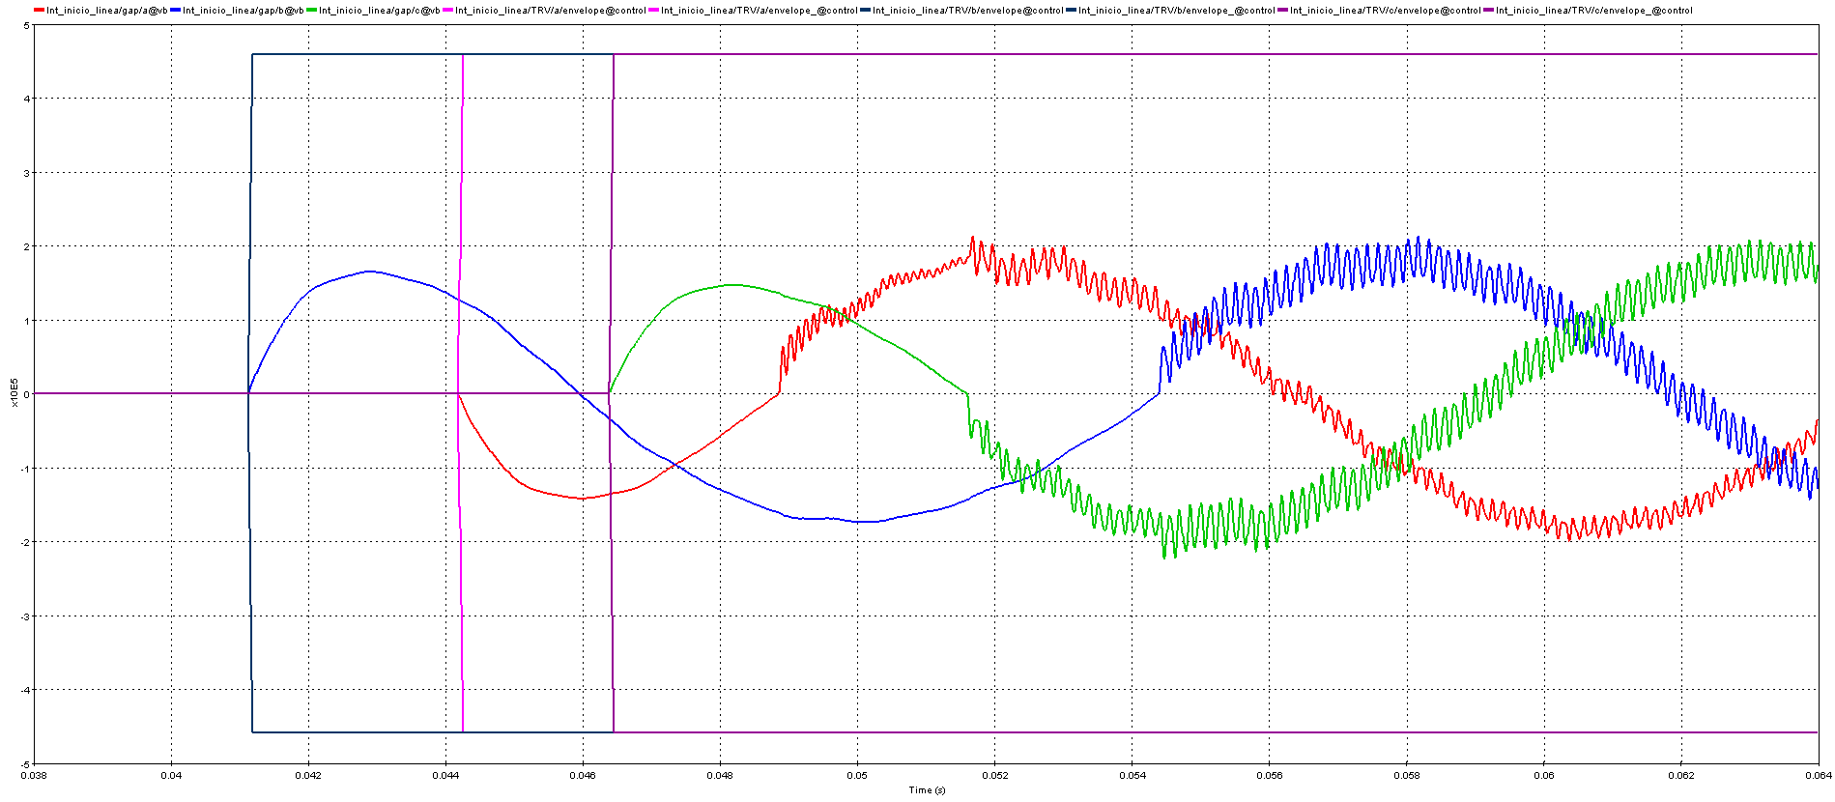
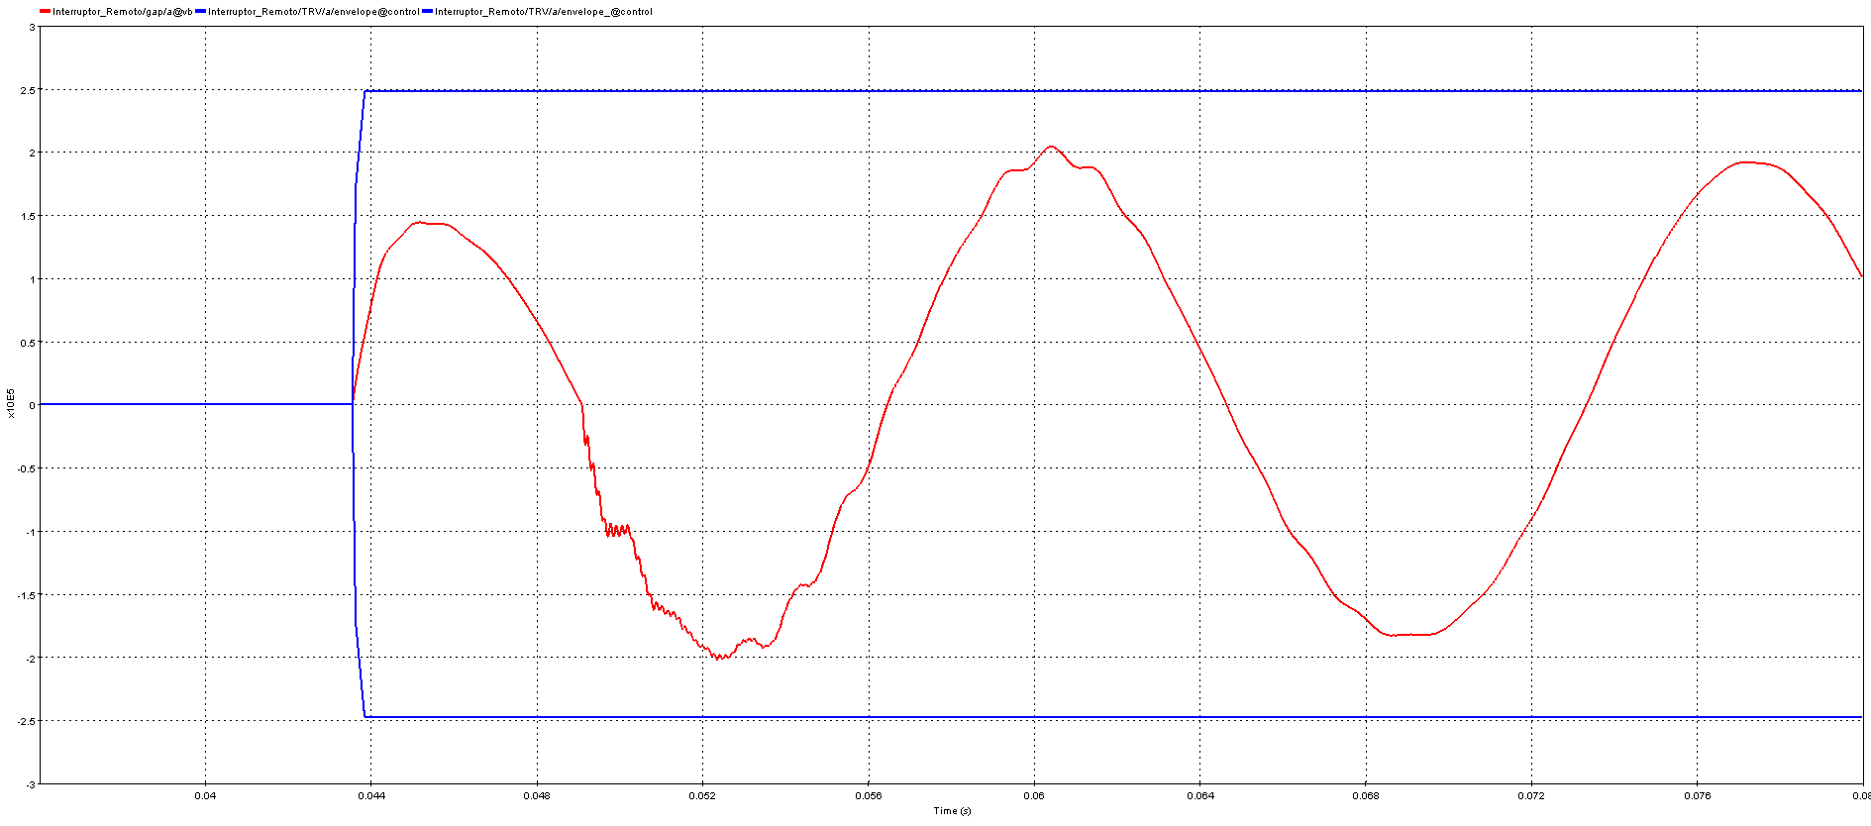
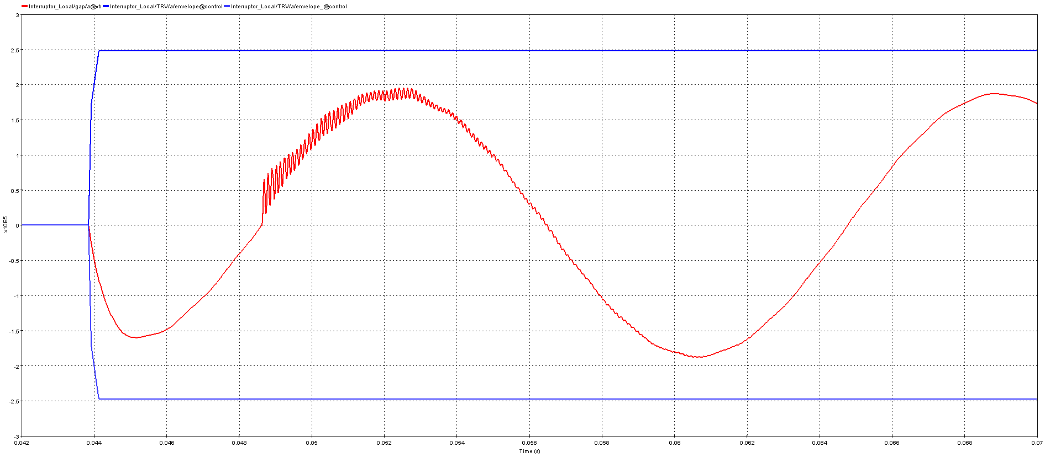
Improvement of TRV
TRV assessment with mitigation actions

Slide 18
Improvement of TRV
TRV assessment with mitigation actions

Slide 19
Recommendations
Having a detailed physical layout of the substation, including all elements and equipment in the area of influence, is essential to accurately determine the capacitive contribution. This will allow for highly realistic and well-founded results.
Evaluate the different operating scenarios and dispatch of the electrical system.
Perform a statistical analysis considering different operating times of the circuit breaker.

Slide 20
Conclusion
Each switch in the hydroelectric power plant substation was evaluated by simulating contingencies due to out-of-phase opening, terminal faults, and kilometer-long faults.
It has been found that kilométric faults in the project's line circuit breaker exceed the envelopes recommended by the IEC 62271-100 standard.
According to the study results, the substation equipment will be protected by installing pre-insertion resistors to prevent arc reignition when the circuit breaker poles open.

Slide 21
THANK YOU!

